Slide 1
Lesson 1
Intro to API Calls
Cornell University
Systems Engineering
Dr. Tim Fraser
Assistant Teaching Professor

Slide 2
Summary
Date
01
02
03
04
05
06
What’s an API?
HTTP and Endpoints
What is curl?
API Call Methods
Calling APIs
in Python
Calling APIs
in R
🌐
📬
📮
🔌
🐍
🆁
Slide 00
Slide 00
Slide 00
Slide 00
Slide 00
Slide 00

Slide 3
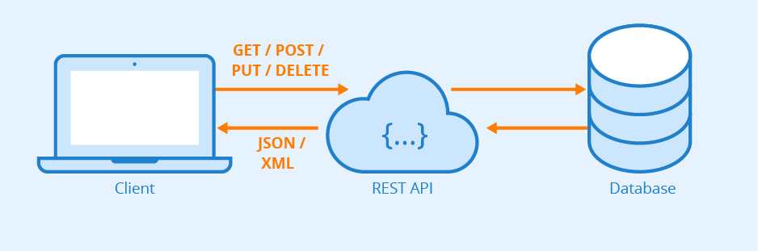
🌐What is an API?
Date
📡 API = Application Programming Interface
APIs let two systems communicate.
In web APIs, this usually means: your code ⇄ server over HTTP.
You send a request; the server sends back a response (usually in JSON or XML).
Uses URLs to communicate! (google.com/…)
APIs are the infrastructure behind the entire internet!
🌐Example APIs
US Census API (census data)
TIGERweb API (maps)
OpenWeatherAPI
Notes:
Image source: https://www.altexsoft.com/media/2021/03/rest_api_works.png

Slide 4
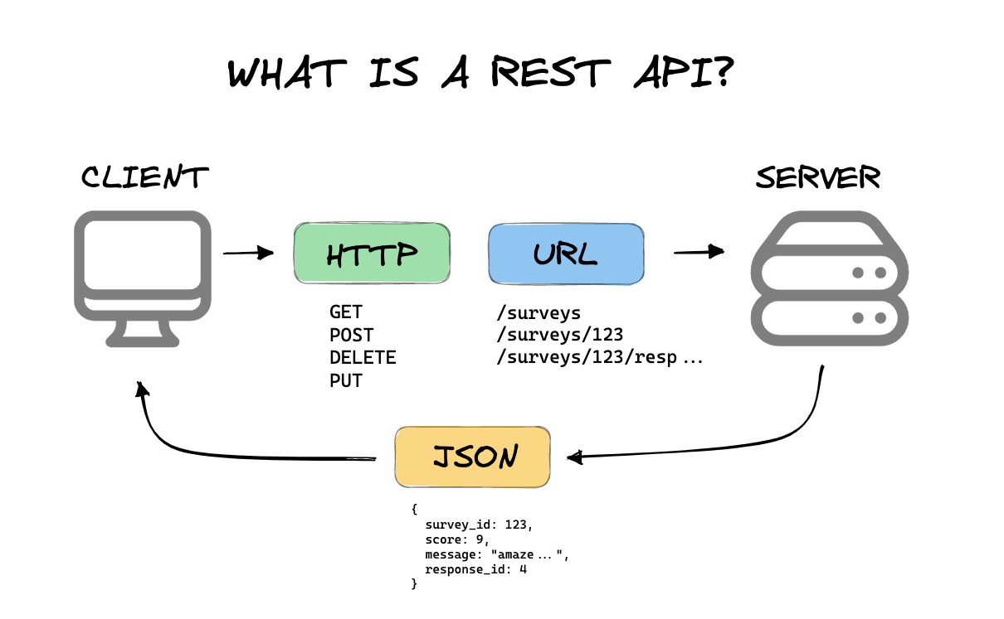
📬HTTP and Endpoints (1)
Date
HyperText Transfer Protocol (HTTP) is how web browsers (and code) talk to web servers.
Key HTTP components:
✉️ URL
The “endpoint” you’re calling
🔌Method
Type of action you’re taking (GET, POST, PUT, DELETE)
🗝️Headers
Metadata (e.g., authentication tokens, content type).
📦 Body
Body: Extra info sent with request (usually with POST/PUT).
Learn more

Slide 5
📬HTTP and Endpoints (2)
Date
📨 Example Endpoint
An Endpoint is a specific URL where an API makes a resource available.
It defines what you can access, where, and how.
Full request:
curl -X GET "https://reqres.in/api/users?page=1&id=5"
*curl is a tool for querying APIs.
*NOTE: you’ll need an API key for this query to work. See next slides!
🏠 Base URL
https://reqres.in
🚪Endpoint Path
/api/users/2
🔌Method
🧩 Query Syntax
GET → retrieve information
🔍 Query Parameters
? → starts the query; everything after this is a parameter, not an endpoint
& → separates one query parameter from another; only necessary if multiple parameters
?page=2&id=5
Learn more

Slide 6
📮What is curl?
Date
📨 Example curl requests
# Get data
curl -X GET "https://reqres.in/api/users/2" \
-H "x-api-key: reqres-free-v1"
# Post new data
curl -X POST "https://reqres.in/api/users" \
-H "Content-Type: application/json" \
-H "x-api-key: reqres-free-v1" \
-d '{"name": "Ada Lovelace", "job": "engineer"}'
*NOTE: you’ll need an API key for this query to work. See next slides!
curl = Client for URLs
A command-line tool to send HTTP requests.
Popular for quick testing and scripting.
Can install for git bash terminal, R, Python, etc.
🔌 -X
Sets the Method (GET, POST, etc.)
🗝️-H
adds Headers
🧩 How to get curl in terminal
📦-d
Install git [LINK]
Auto installs git bash language
Auto installs curl
Adds Data (used with POST queries)
Learn more

Slide 7
🔐Security and Authentication
Date
🔍 API Key as Query Parameter
Why do APIs need authentication?
To control access
To track usage (rate limiting, quotas)
To prevent abuse or scraping
Depending on the API, you can setup authentication either with a Query Parameter or a Header Field.
(Query Parameter is easiest for you to do yourself.)
curl -X GET "https://api.openweathermap.org/data/2.5/weather?q=Ithaca,US&appid=YOUR_API_KEY”
Metaphor: Write passcode on your envelope address
🗝️ Key/Token in Header Field
curl -X GET "https://reqres.in/api/users/2" \
-H "x-api-key: YOUR_API_KEY"
Metaphor: Include delivery instructions in your Amazon order
Learn more

Slide 8
🔌API Call Methods
Date
✅
🚀
📝
🛠️
❌
GET
Retrieve data
POST
Share new data
PUT
Replace existing data
PATCH
Partially updated existing data
DELETE
Remove data
curl -X GET "https://reqres.in/api/users/2" \
-H "x-api-key: YOUR_API_KEY"
curl -X POST "https://reqres.in/api/users" \
-H "Content-Type: application/json" \
-H "x-api-key: YOUR_API_KEY" \
-d '{"name": "Ada Lovelace", "job": "engineer"}'
curl -X PUT "https://reqres.in/api/users/2" \
-H "Content-Type: application/json" \
-H "x-api-key: YOUR_API_KEY" \
-d '{"name": "Ada Lovelace", "job": "scientist"}'
curl -X PATCH "https://reqres.in/api/users/2" \
-H "Content-Type: application/json" \
-H "x-api-key: YOUR_API_KEY" \
-d '{"job": "mathematician"}'
curl -X DELETE "https://reqres.in/api/users/2" \
-H "x-api-key: YOUR_API_KEY"
These use a single REAL API key, limited to 100 calls per hour.
Get your own API key here: https://reqres.in/signup
Then, try out these real examples in a Git Bash terminal using curl!

Slide 9
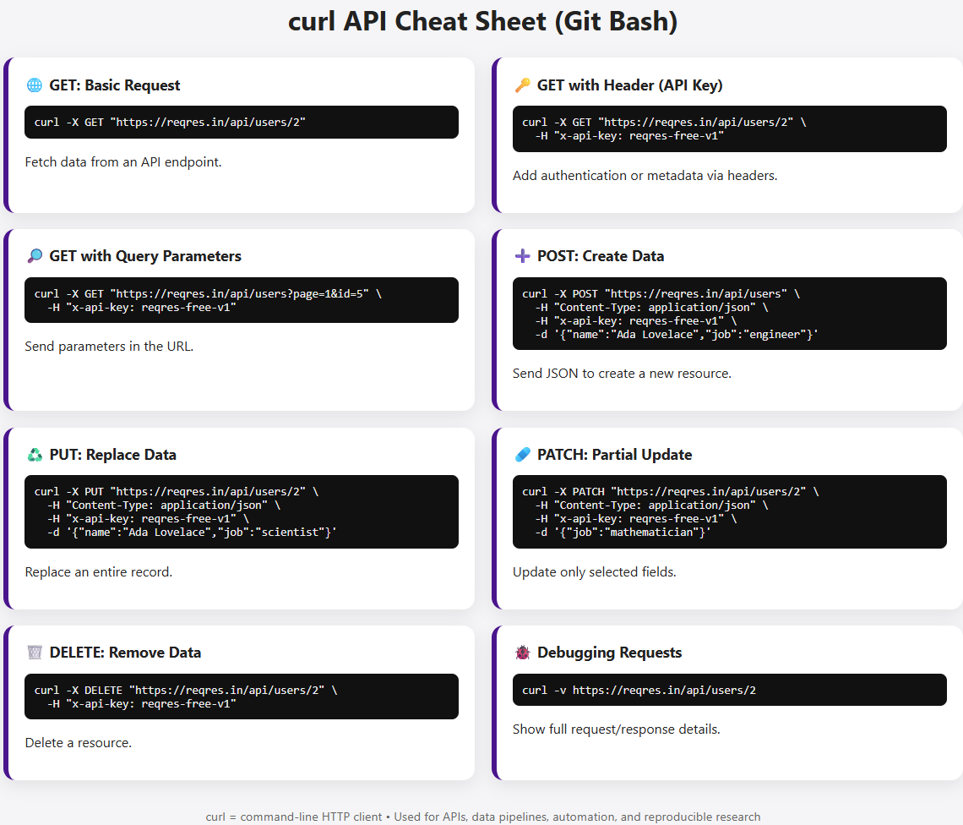
🔌API Call
Methods (2)
Date
Some APIs work with no API KEY…
But most need an API key.
curl
CheatSheet
Try out these real examples in a Git Bash terminal using curl!
These use a single REAL API key, limited to 100 calls per hour.
Get your own API key here: https://reqres.in/signup
Credit: Tim & GPT
Pro Tip:
Make .html cheatsheets for yourself with AI!

Slide 10
🐍 Calling APIs in Python
Date
🐍 Example in Python
Requirements: install Python, pip, and requests library
Python’s requests library is a powerful and beginner-friendly tool for making HTTP calls.
Use .get(), .post(), .put(), etc.
Headers can be passed like headers={“X”: “Y”}
Data can be passed via params=, data=, or json=
Returns response metadata (status_code) and body (.json())
# !pip install requests # install library if haven’t yet
# Load requests library
import requests
# Execute query and save response as object
response = requests.get(
"https://reqres.in/api/users/2",
headers={"x-api-key": "reqres-free-v1"}
)
# View response
print(response.status_code) # 200 = success!
print(response.json())
Update with your API key.

Slide 11
🆁 Calling APIs in R
Date
🆁 Example in R
Requirements: install R and httr2 and jsonlite libraries
R’s httr2 package provides a modern, pipeable approach to working with APIs.
Chainable functions (req_*) build up the request
Use req_perform() to send it and return a response
Cleanly separates URL, headers, method, and body
Uses pipe |> to chain on next function
# Install if you haven’t yet
# install.packages(c(“httr2”, “jsonlite”))
# Execute query and save response as object
library(httr2)
library(jsonlite)
# Create request object
req = request("https://reqres.in/api/users/2") |>
req_headers(`x-api-key` = "reqres-free-v1") |>
req_method("GET")
# Execute request and store result as object
resp = req_perform(req)
# Check status
resp$status_code # 200 = success
# Return response as a json
resp_body_json(resp)
# Convert JSON to R list object
fromJSON(resp_body_json(resp))
Update with your API key.

Slide 12
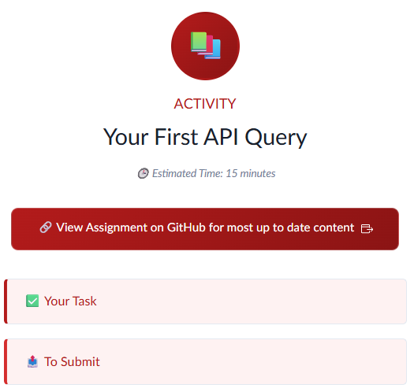
🌐ACTIVITY
✅Run your first API query!
Use our existing code on github to run a test API query in R or Python!
Remember to submit evidence (screenshot) on CANVAS!
github.com/timothyfraser/dsai/blob/main/01_query_api/ACTIVITY_first_query.md
Notes:
Image source: https://www.altexsoft.com/media/2021/03/rest_api_works.png

Slide 13
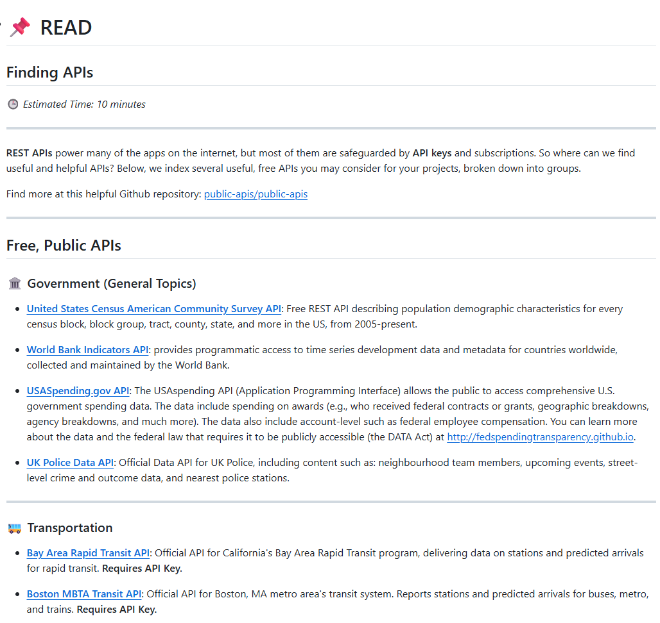
🌐READ
✅Find Your API of Interest!
Review our enormous collection of public APIs and find one that you want to use in your work throughout this term!
Suggestion: Pick 2! 1 for individual work, 1 for group project.
github.com/timothyfraser/dsai/blob/main/01_query_api/READ_find_apis.md
Notes:
Image source: https://www.altexsoft.com/media/2021/03/rest_api_works.png

Slide 14
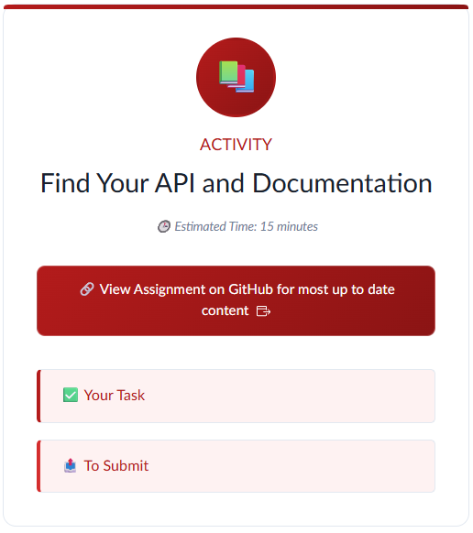
🌐ACTIVITY
✅Find Your API of Interest!
Review our enormous collection of public APIs and find one that you want to use in your work throughout this term!
Suggestion: Pick 2! 1 for individual work, 1 for group project.
Remember to submit evidence (screenshot) on CANVAS!
Notes:
Image source: https://www.altexsoft.com/media/2021/03/rest_api_works.png

Slide 15
Happy coding!

